Slide 1

Ukhuseleko: A Safe Haven Against GBV with AI
Ukhuseleko is a comprehensive digital platform providing support and resources for individuals affected by Gender-Based Violence in South Africa. It addresses a critical information gap by offering legal guidance, support services, and a confidential communication space for survivors who often lack access to clear, trustworthy information about their rights and available help.

Slide 2
Understanding Gender-Based Violence
Physical Violence
Sexual Violence
Acts causing bodily harm: assault, beating, slapping, kicking, or strangling
Non-consensual acts including rape, sexual assault, and harassment, with high rates in South Africa
Emotional Abuse
Economic Abuse
Undermining self-worth through verbal abuse, intimidation, threats, gaslighting, and manipulation
Restricting economic independence, preventing work, or withholding money for basic needs
GBV is a widespread human rights violation that occurs across all segments of society, primarily affecting women and girls while causing harm to families and entire communities.

Slide 3
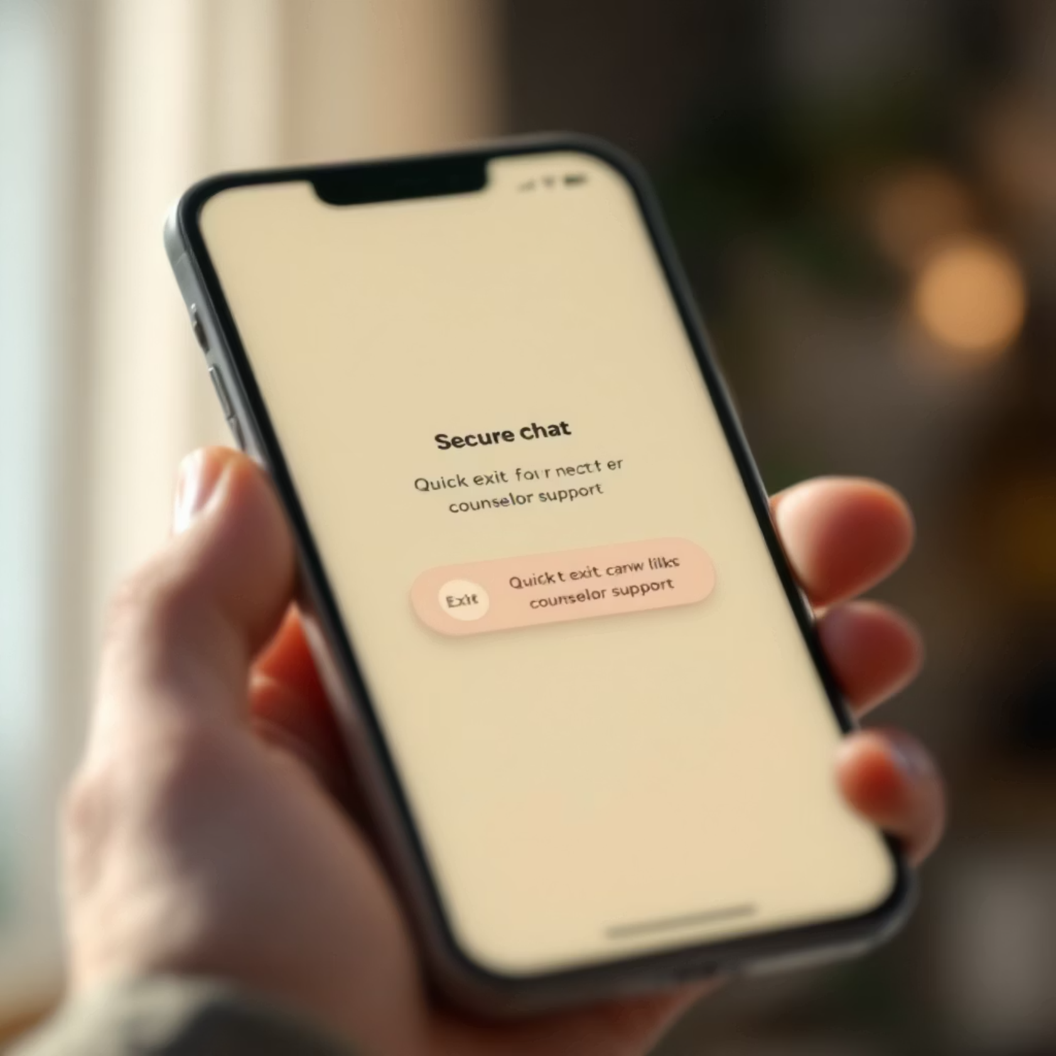
AI-Powered Support Features
Safe Haven Chat Room
Confidential, anonymous support with counselors and "Quick Exit" button for immediate safety
Resource Location
Map-based tool to find nearby police stations, hospitals, and support centers with filtering options
Story Analysis
"Share Your Story" feature collects narratives to identify patterns and trends for better resource allocation

Slide 4

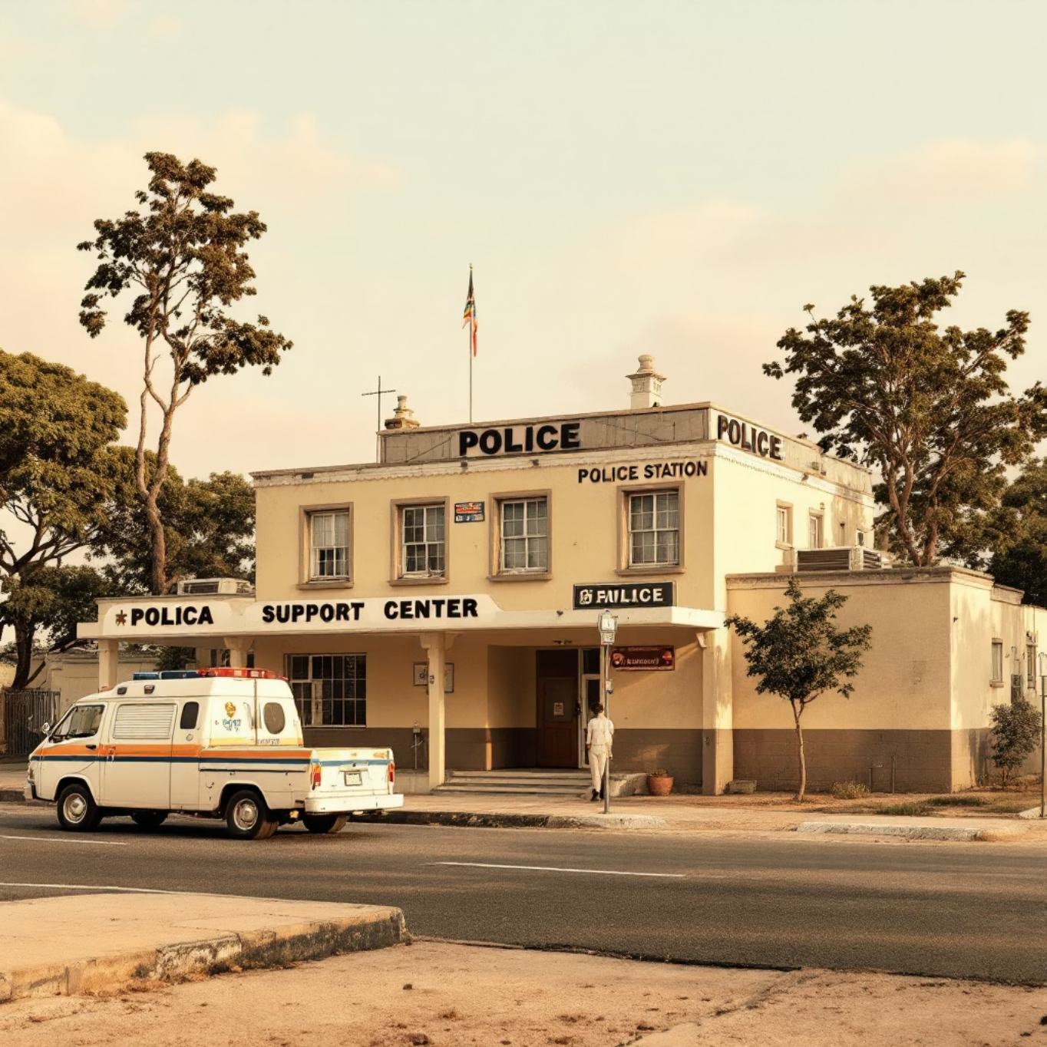
Legal and Emergency Support
The Domestic Violence Act 116 of 1998
Emergency Contacts
Provides protection by recognizing various forms of abuse:
SAPS Emergency: 10111
Physical abuse
GBV Command Centre: 0800 428 428
Sexual abuse
Lifeline's Helpline: 0800 150 150
Emotional and psychological abuse
Legal Aid South Africa: 0800 110 110
Economic abuse
Harassment and stalking
The platform outlines five key steps to obtaining a protection order, legally enforceable throughout South Africa.

Slide 5

A Path Forward
Ukhuseleko demonstrates a powerful synergy between technology and social good, providing a crucial lifeline for survivors of GBV.
By integrating anonymous chat, AI-powered location services, and comprehensive legal resources, Ukhuseleko directly addresses South Africa's information gap. The platform empowers individuals with the knowledge and tools they need to seek help, find justice, and begin their healing journey.

